Slide 1

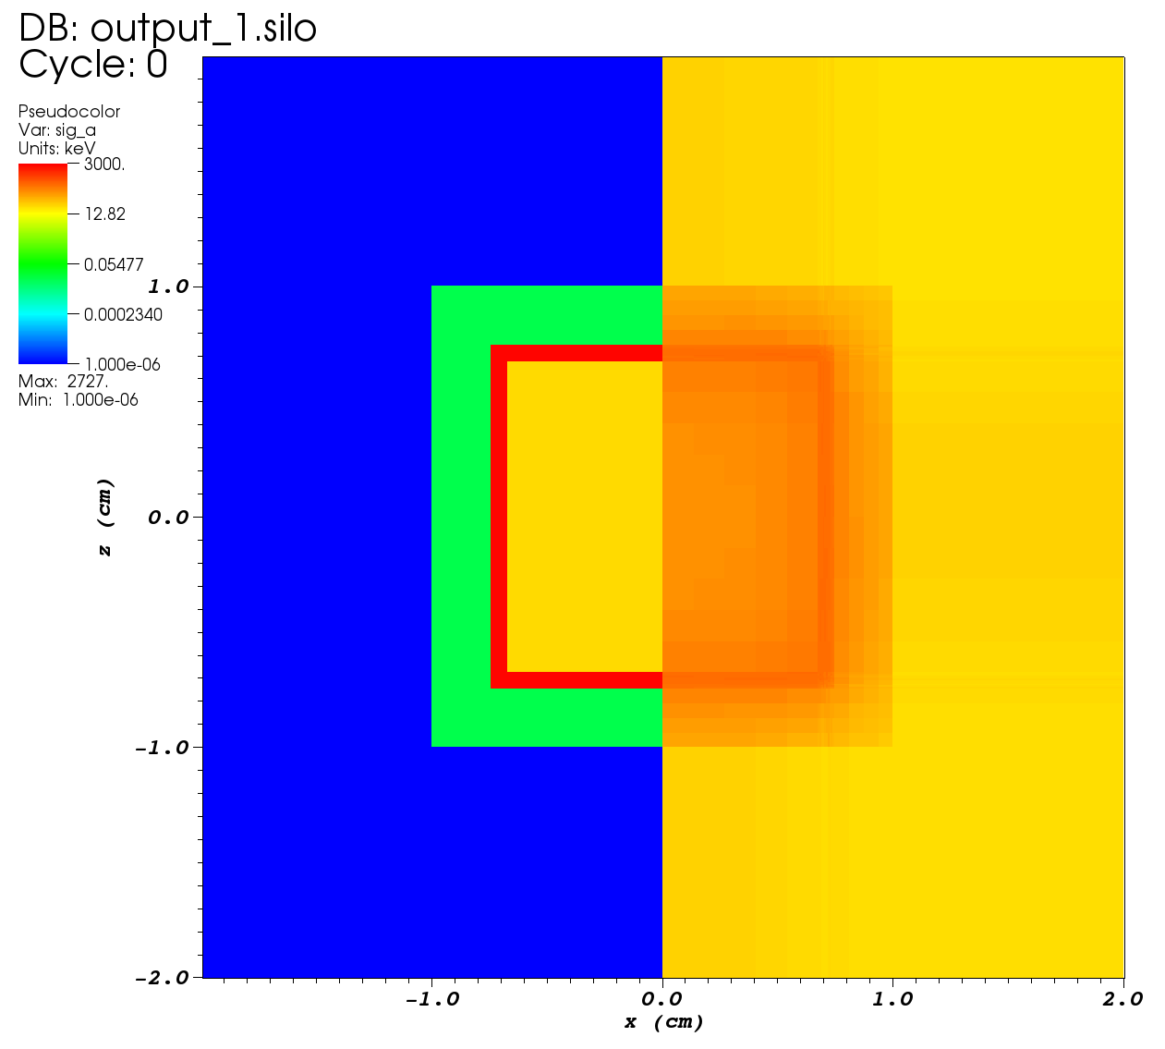
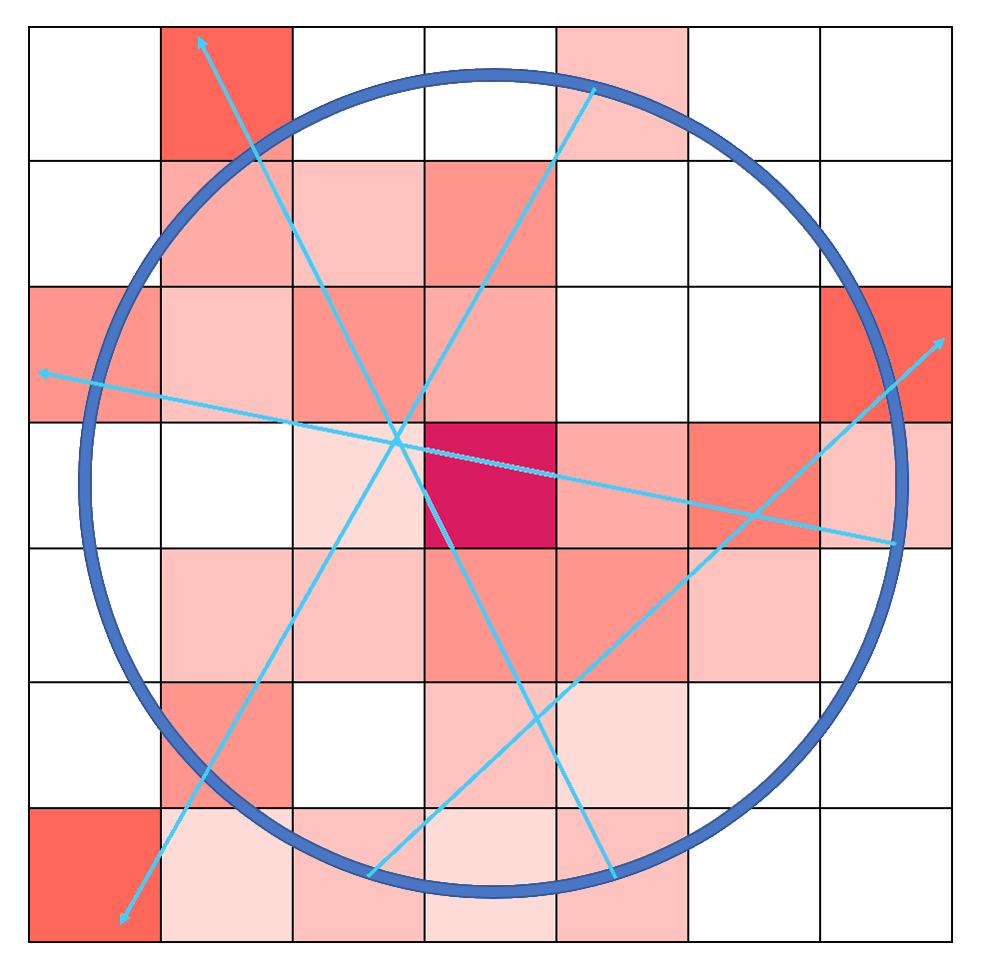
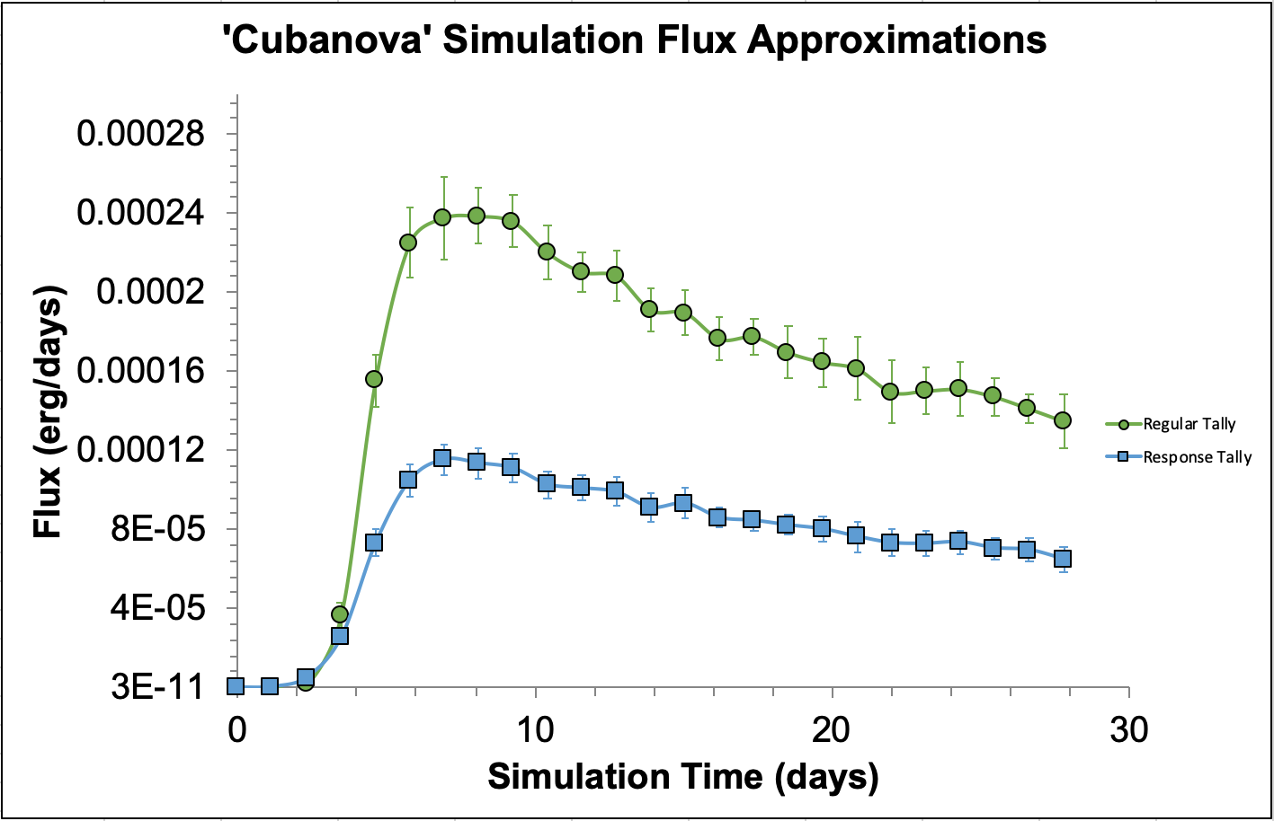
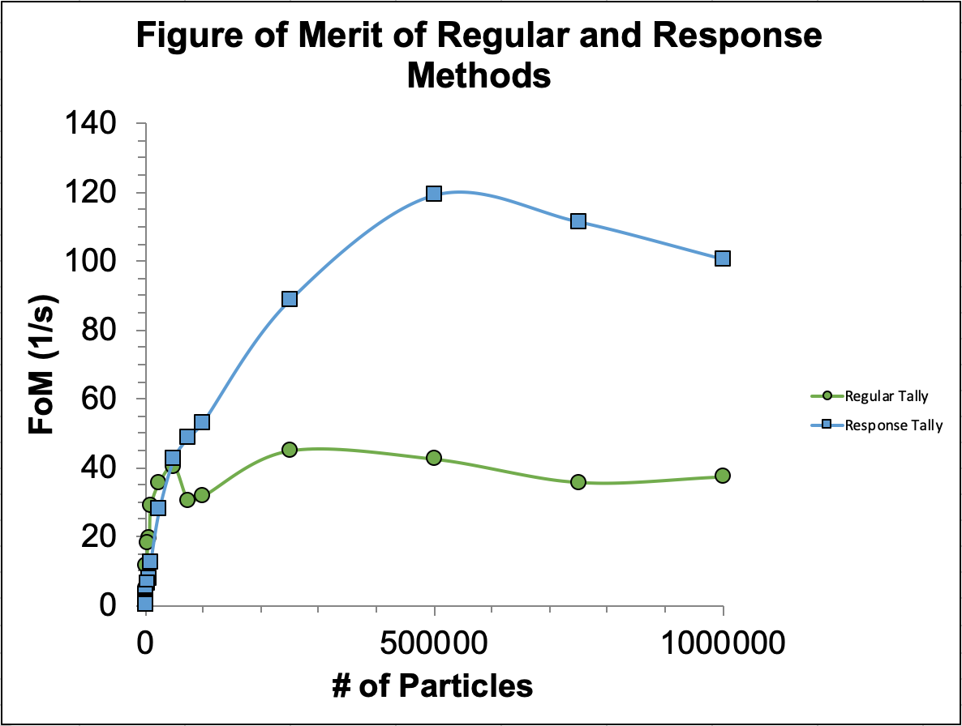
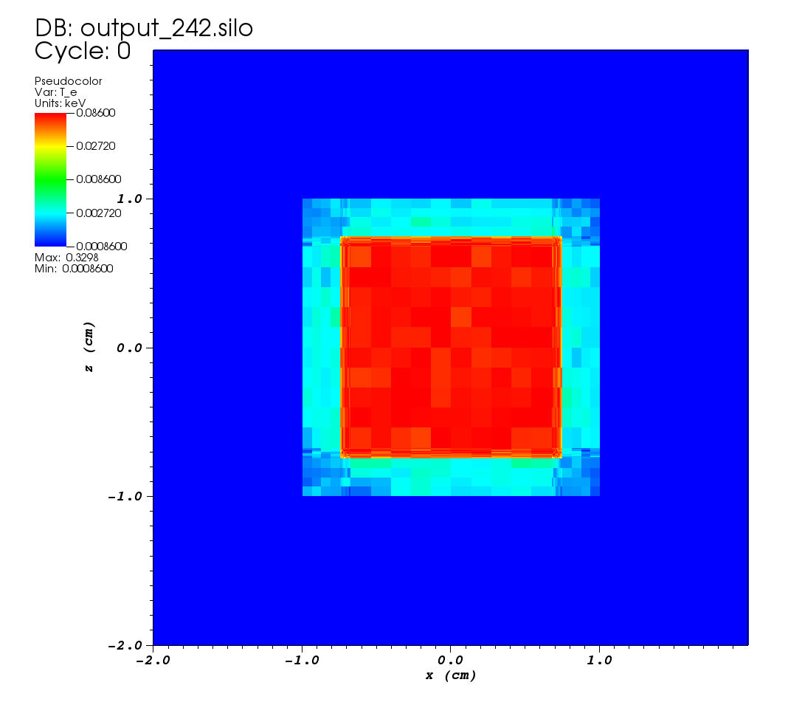
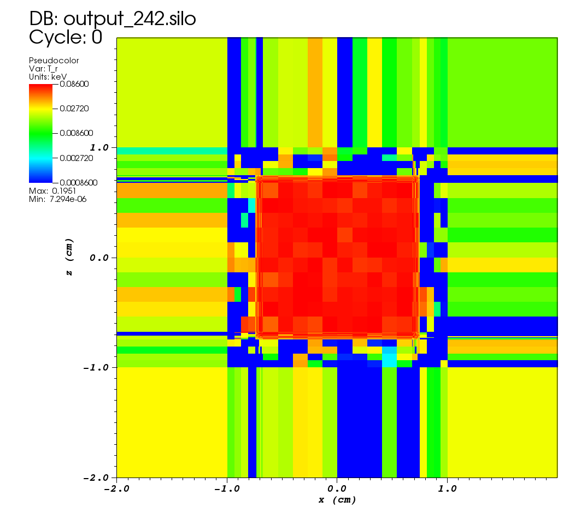
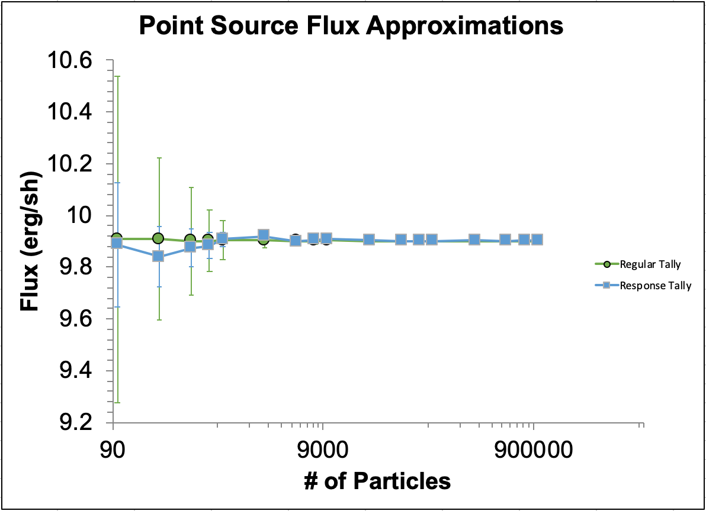
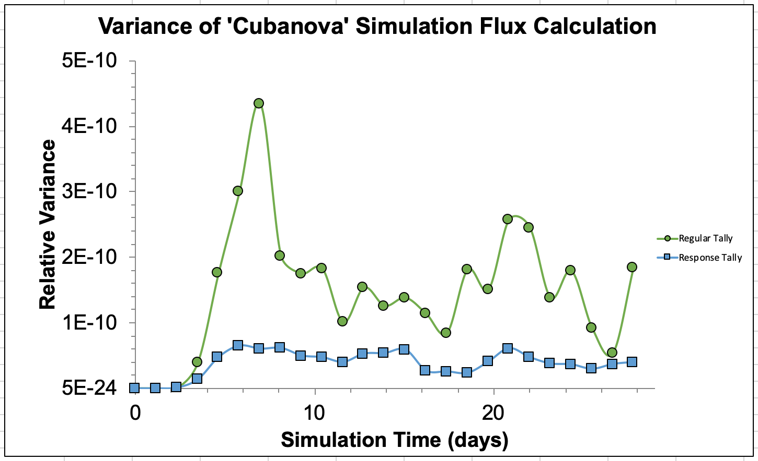
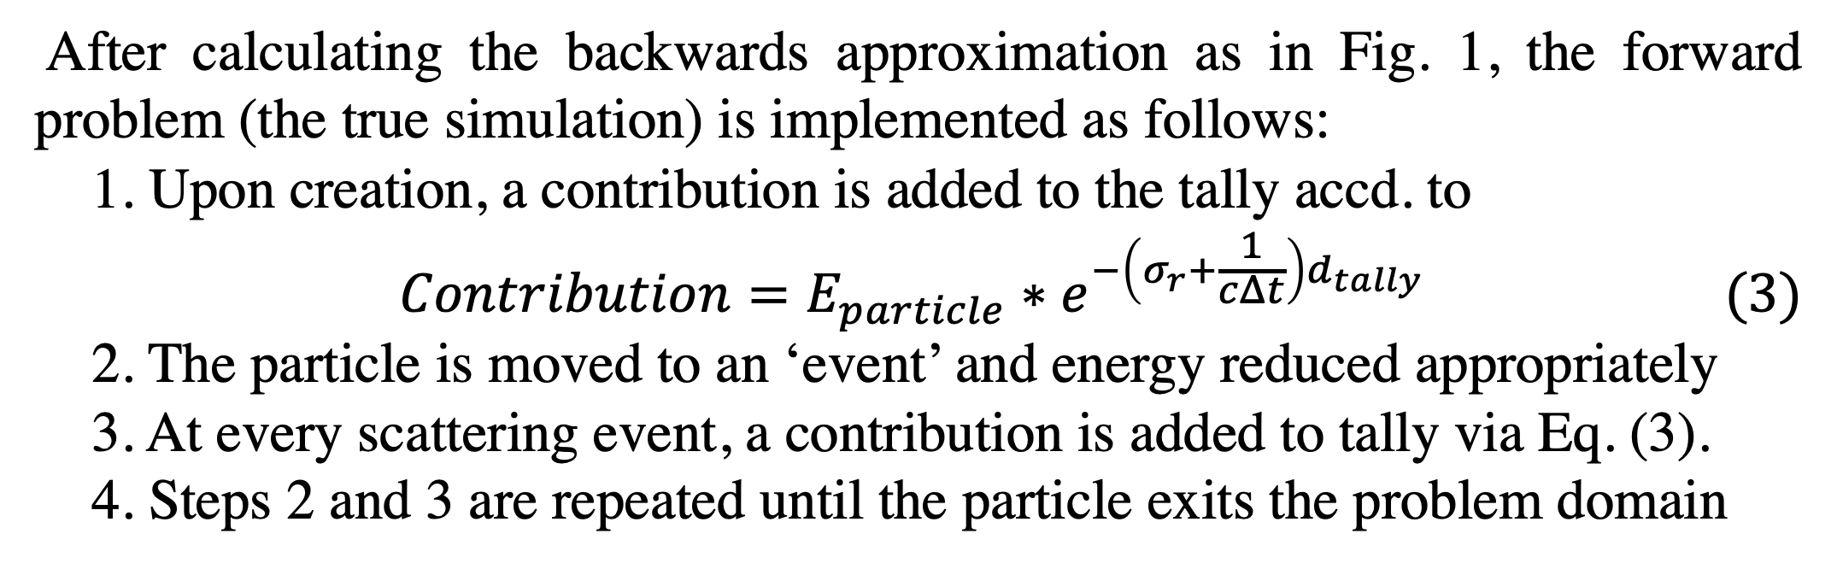
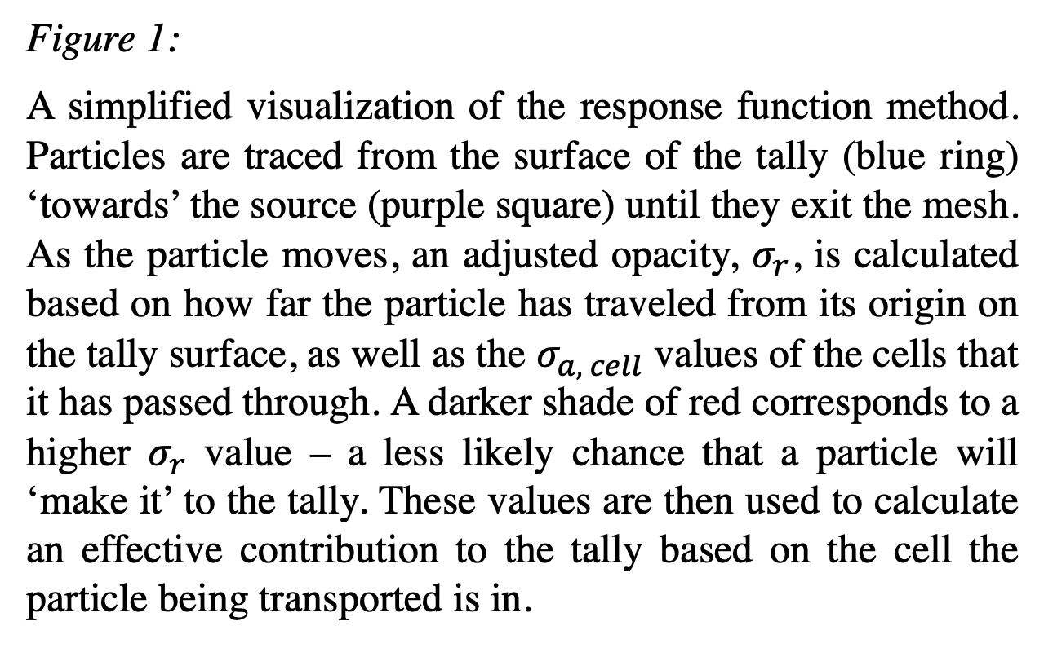
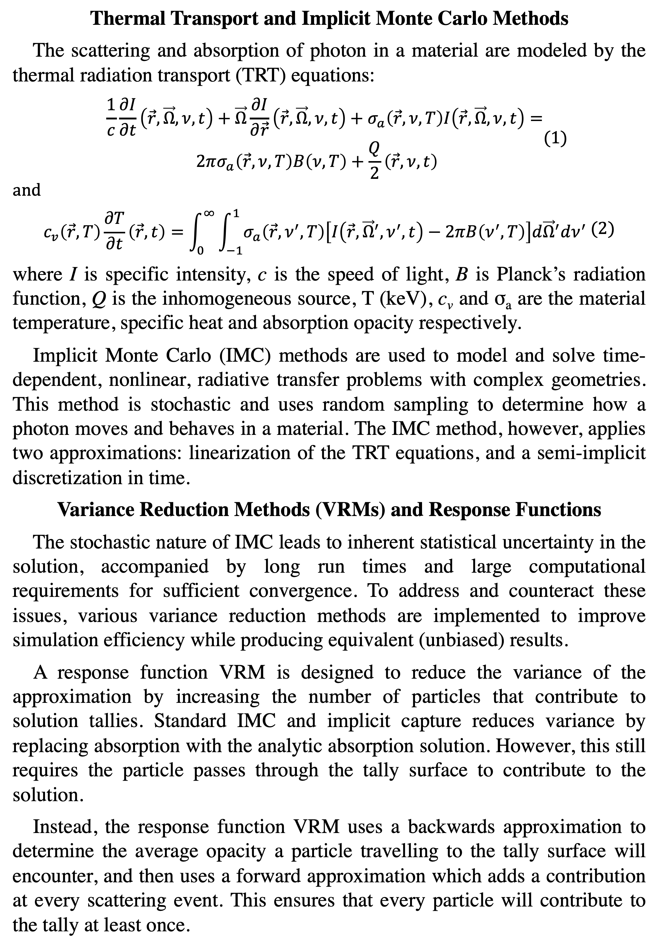
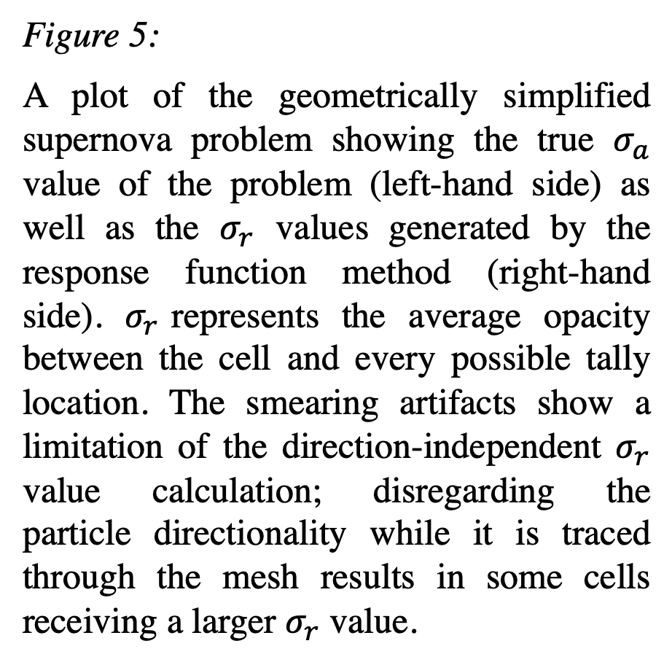
Variance Reduction at Scale: Response Function Methods
for IMC Thermal Transport Problems
Scott Campbell, Gonzaga University
Mentors: Mathew Cleveland, Kendra Long, Ryan Wollaeger
Introduction & Background
Method
Figure 5:
A plot of the geometrically simplified supernova problem showing the true $σ_{a}$ value of the problem (left-hand side) as well as the $σ_{r}$ values generated by the response function method (right-hand side). $σ_{r}$represents the average opacity between the cell and every possible tally location. The smearing artifacts show a limitation of the direction-independent $σ_{r}$ value calculation; disregarding the particle directionality while it is traced through the mesh results in some cells receiving a larger $σ_{r}$ value.
Thermal Transport and Implicit Monte Carlo Methods
The scattering and absorption of photon in a material are modeled by the thermal radiation transport (TRT) equations:
$$\begin{aligned}\begin{aligned} \frac{1}{c}\frac{∂I}{∂t}\left(\vec{r}, \vec{Ω}, ν, t\right)+\vec{Ω}\frac{∂I}{∂\vec{r}}\left(\vec{r}, \vec{Ω}, ν, t\right)+σ_{a}\left(\vec{r}, ν,T\right)I\left(\vec{r},\vec{Ω}, ν,t\right)= \\ 2πσ_{a}\left(\vec{r},ν,T\right)B\left(ν, T\right)+\frac{Q}{2}\left(\vec{r},ν, t\right)\end{aligned}\#\#(1)\end{aligned}$$
and
$$\begin{aligned}\begin{aligned}\begin{aligned} \\ c_{v}\left(\vec{r},T\right)\frac{∂T}{∂t}\left(\vec{r},t\right)=\int_{0}^{∞}{\int_{−1}^{1}{σ_{a}\left(\vec{r},ν^{′}, T\right)\left[I\left(\vec{r},{\vec{Ω}}^{′},ν^{′},t\right)−2πB\left(ν^{′},T\right)\right]d{\vec{Ω}}^{′}dν^{′}}} \#\end{aligned}\end{aligned}\#\#(2)\end{aligned}$$
where I is specific intensity, c is the speed of light, B is Planck’s radiation function, Q is the inhomogeneous source, T (keV), c_{v} and σ_{a} are the material temperature, specific heat and absorption opacity respectively.
Implicit Monte Carlo (IMC) methods are used to model and solve time-dependent, nonlinear, radiative transfer problems with complex geometries. This method is stochastic and uses random sampling to determine how a photon moves and behaves in a material. The IMC method, however, applies two approximations: linearization of the TRT equations, and a semi-implicit discretization in time.
Variance Reduction Methods (VRMs) and Response Functions
The stochastic nature of IMC leads to inherent statistical uncertainty in the solution, accompanied by long run times and large computational requirements for sufficient convergence. To address and counteract these issues, various variance reduction methods are implemented to improve simulation efficiency while producing equivalent (unbiased) results.
A response function VRM is designed to reduce the variance of the approximation by increasing the number of particles that contribute to solution tallies. Standard IMC and implicit capture reduces variance by replacing absorption with the analytic absorption solution. However, this still requires the particle passes through the tally surface to contribute to the solution.
Instead, the response function VRM uses a backwards approximation to determine the average opacity a particle travelling to the tally surface will encounter, and then uses a forward approximation which adds a contribution at every scattering event. This ensures that every particle will contribute to the tally at least once.
The response function VRM was designed and implemented around a simplified point source problem of a single heated cell as shown in Fig. 1:
Figure 1:
A simplified visualization of the response function method. Particles are traced from the surface of the tally (blue ring) ‘towards’ the source (purple square) until they exit the mesh. As the particle moves, an adjusted opacity, $σ_{r}$, is calculated based on how far the particle has traveled from its origin on the tally surface, as well as the $σ_{a, cell}$ values of the cells that it has passed through. A darker shade of red corresponds to a higher $σ_{r}$ value – a less likely chance that a particle will ‘make it’ to the tally. These values are then used to calculate an effective contribution to the tally based on the cell the particle being transported is in.
After calculating the backwards approximation as in Fig. 1, the forward problem (the true simulation) is implemented as follows:
1. Upon creation, a contribution is added to the tally accd. to
$$\begin{aligned}Contribution=E_{particle}∗e^{−\left(σ_{r}+\frac{1}{cΔt}\right)d_{tally}} \#\#(3)\end{aligned}$$
2. The particle is moved to an ‘event’ and energy reduced appropriately
3. At every scattering event, a contribution is added to tally via Eq. (3).
4. Steps 2 and 3 are repeated until the particle exits the problem domain
Figure 6:
The relative flux calculations made by the regular tally method and the response function tally method. As in Fig. 3, the response method has a smaller variance, however, it also drastically underestimates the flux. This likely stems from the use of a spherical tally surface instead of a directional tally surface for this particular problem.
Results
Figure 2:
A graph showing the figure of merits (FoM) of the regular tally method as well as the response function. A higher FoM corresponds to a method that provides less variance in a more efficient span of time. This figure shows that after approx. 50k particles, our method results in a greatly improved FoM compared to a regular tally. This provides a strong basis for the usefulness of our method.
Figure 3:
A graph showing the average values of the flux for a point source problem as well as the variance as a function of the number of particles used in the simulation. This shows that our method has far less variance for fewer simulated particles, which implies that it is a more reliable method under these conditions. Data point 2 appears to be an anomaly – likely resulting from statistics or a minor bug in our code.
Figure 7:
These plots show the electron temperature (left) and the radiative temperature (right) at the end of the simulation shown in Figs. 4, 5 & 6. Overheating in the left plot likely results from small corner cells. The noise in the radiation field results from a limited number of photons, the optical thickness of the material, and the coarse mesh granularity of the void region.
Conclusions
Research Objective
Our investigation into the use of a response function-based variance reduction method for use in simulations modeling supernova interactions with its circumstellar medium has shown a notable improvement in variance over standard methods.
The lack or directionality in the response function likely causes the method to under-predict the flux for a spherical tally. We do expect that the method will preform significantly better for other tally geometries, i.e. planes, as the directionality is more obviously built into the response.
Future work will be looking at potentially improving the directionality of the response function and its performance for other tally geometries.
The objective of this research is to investigate the advantages and drawbacks of a response function VRM for IMC simulations. Specifically, this method is analyzed for use in modeling astrophysical events such as multidimensional supernova transients. The goal is to provide high-quality simulation data to astrophysicists, who compare these results to physical observations.
Additionally, the project investigates the figure of merit of the response function VRM as well as the cases in which the method breaks down. This is accomplished by analyzing the method results over a range of problems and comparing the variance of the standard vs response function based methods.
Figure 4:
A graph demonstrating the variance of the regular tally, and response function tally for the simplified supernova simulation from Fig. 5 as a function of the simulation time. Twenty indep. simulations were run with unique random number seeds. The general trends indicate that the response function method has a significantly lower variance at any given time step compared to the regular tally method.
Acknowledgements
We would like to thank the 2019 XCP Computational Physics Workshop and their directors for making this research possible.
Los Alamos National Laboratory
LA-UR-19-27880

